Slide 1
Access Advisory Committee
August 2024

Slide 2
Spare Update
Julie Lampkin, Director of Demand Response Operations

Slide 3
Proposed FY2025 Budget
Emmanuel Toutin, Director of Budget and Financial Planning

Slide 4
Discussion Outline
Budget Development Calendar
Budget Overview
Operating Budget Highlights
Capital Improvement Plan Update

Slide 5
FY2025 Budget Development Calendar
Feb 7 Operating and Capital Budget kick-off meeting with departments
Apr 12 Capital and Operating Budget requests received from departments
May 8 Board Committees review proposed budget calendar
Jun 5 Initial review with Access Advisory Committee
Jun 12 Board Committees initial review and discussion
Jun 12 Initial review with Customer Satisfaction Advisory Committee
Jun 28 Initial review with Public Safety Advisory Committee
Jul 22 Budget proposal presented to Board of Directors

Slide 6

FY2025 Budget Community Engagement
Aug 7 Presentation to Access Advisory Committee
Aug 12 Update Board Committees
Aug 14 Presentation to Customer Satisfaction Advisory Committee
Aug 23 Presentation to Public Safety Advisory Committee
Aug 23 Proposed budget document is published online
Aug 26-30 Budget public outreach and webinar
Sep 11 Update Board Committees
Sep 11 Public hearing on proposed budget and capital improvement plan
Sep 23 Board of Directors considers budget proposal for adoption

Slide 7

Proposed Budget Overview
Proposed budget is structurally sound and balanced
  Ongoing revenue is sufficient to fund operations and provide funds for capital needs
Meets operating reserve requirements
  Statutory operating and budget stabilization reserves are fully funded
Projected sales tax growth of 3% for Fiscal Year 2025
  Declining growth in Fiscal Year 2024
Service funding based on August Service Plan changes
Investment in customer-focused transit infrastructure projects

Slide 8

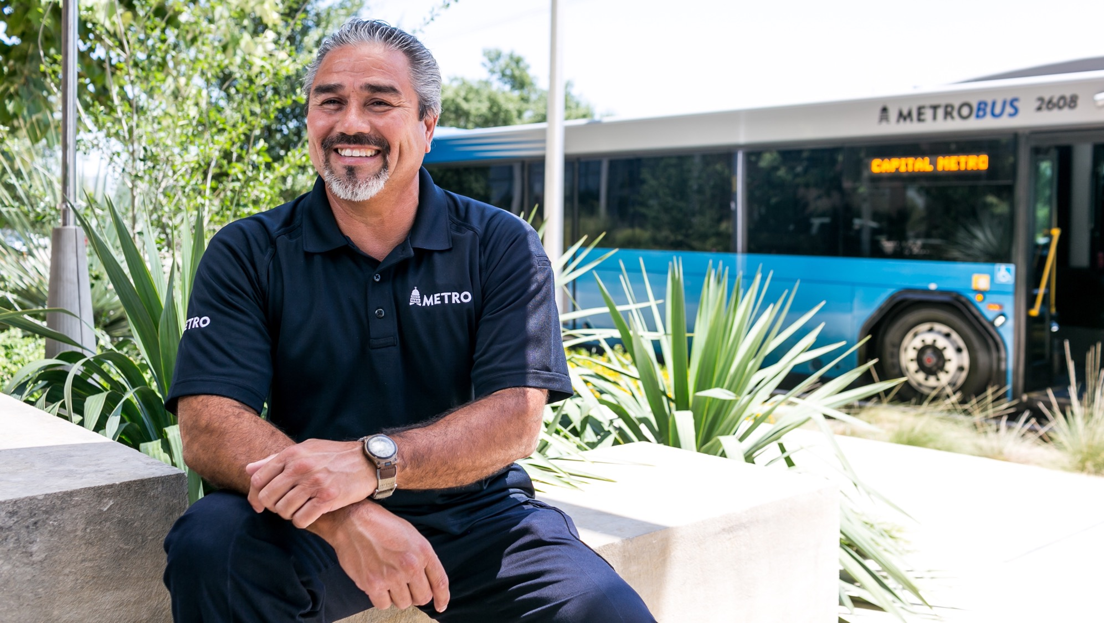

FY2025 OPERATING BUDGET

Slide 9
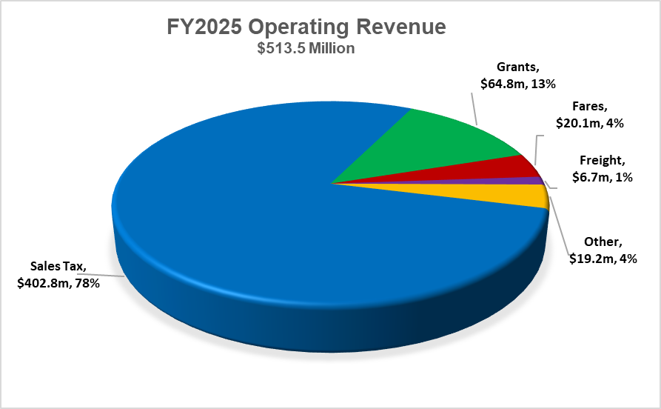
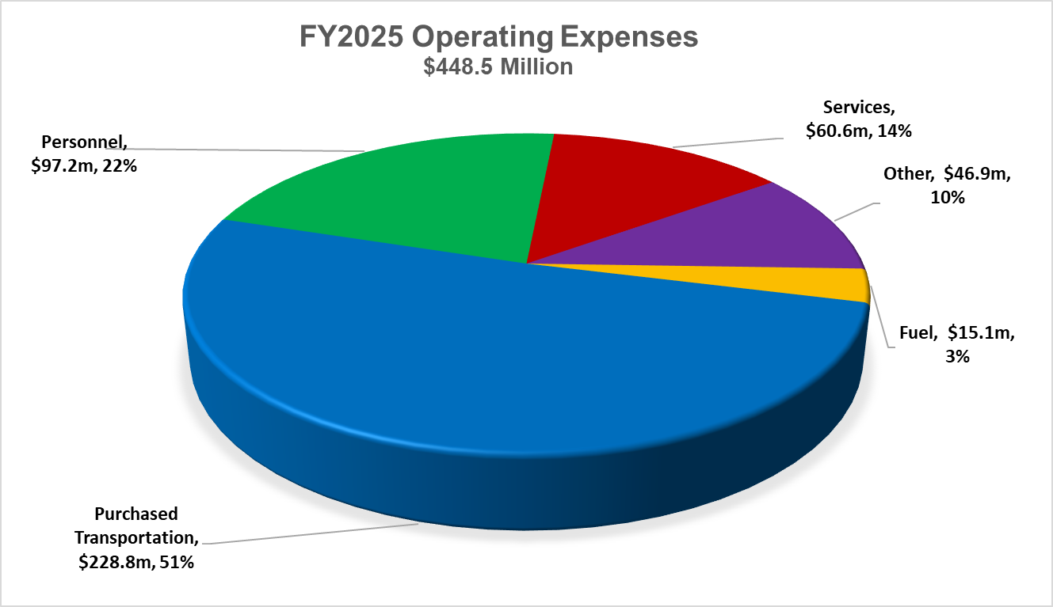
FY2025 Operating Budget Summary
Heavily dependent on sales tax revenue and grants for annual funding
Grants include 5307 formula funds and operating contributions from the Austin Transit Partnership
Majority of the budget pays for contracted transit services
Includes funding for Project Connect operations, maintenance and support services
Fuel increase of 6% per gallon from FY2024

Slide 10
Operating Revenue
Fare Revenue
  Fare revenue based on continuing return of ridership in FY2025
Federal Grants
  Approximately $44.2 million annually in Section 5307 funds
Freight Railroad Revenue
  Mainline revenue on target with FY2024 Budget of $5.4 million
  Section 45G Railroad Track Maintenance Tax Credit of $544 thousand

Slide 11
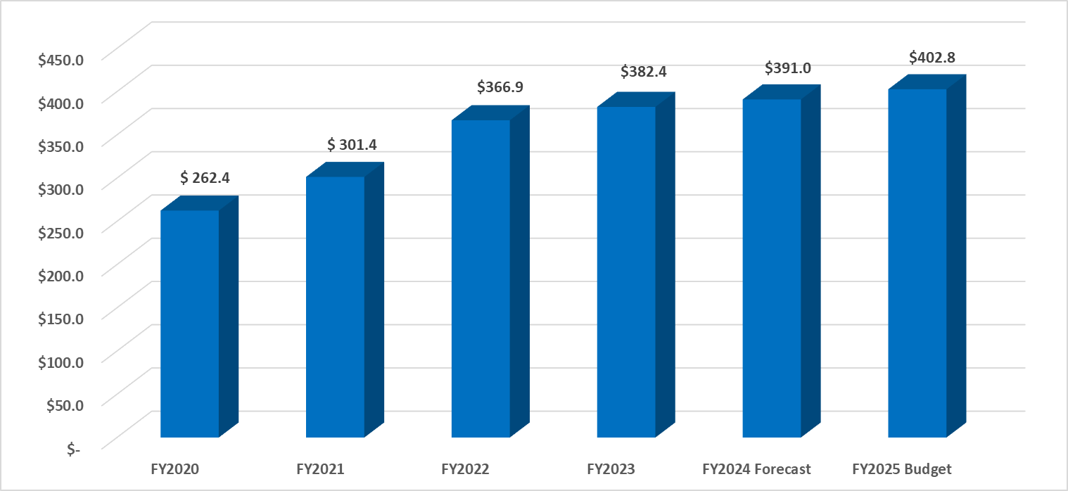
Sales Tax Revenue
$ Million

Slide 12

Operating Cost Drivers
Service levels based on August Service Plan changes
  Purchased transportation costs are developed using budgeted hours and contractual rates
Fuel prices remain stable over the next fiscal year with hedging in place
  Diesel estimate of $2.75 per gallon, inclusive of tax and net of hedging activities
  Fuel hedge is 56% of projected fuel usage
Continuation and expansion of Pickup innovative mobility zones
Performance-based average annualized pay increase for employees
Strategic plan initiatives considered in budget preparation

Slide 13
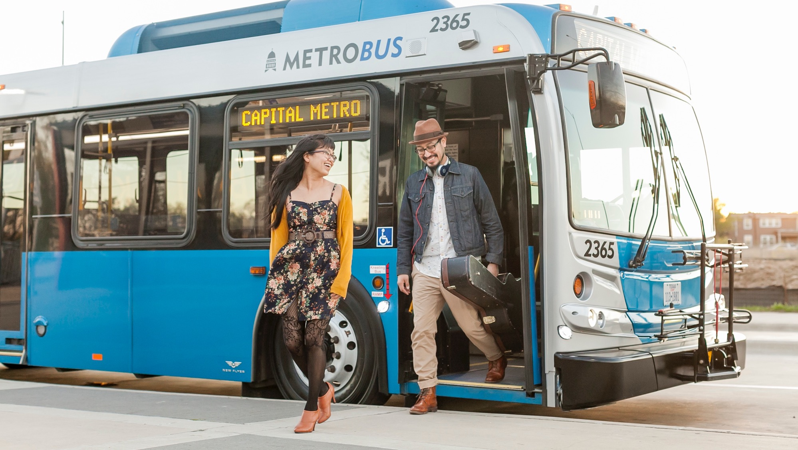
FY2025 CAPITAL BUDGET

Slide 14
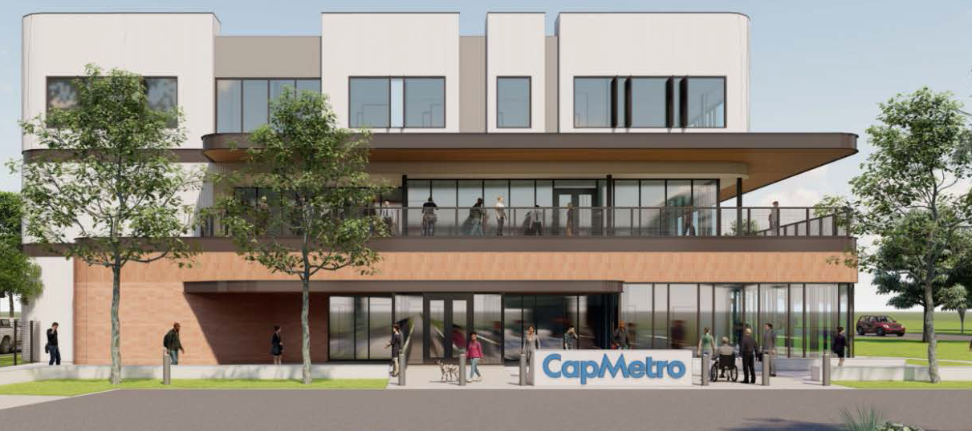
Capital Budget Highlights
North base demand response operations and maintenance facility
Broadmoor Rail Station
Bus stop enhancements and improvements
New headquarters build-out
CapMetro Bikeshare system replacement and expansion

Slide 15
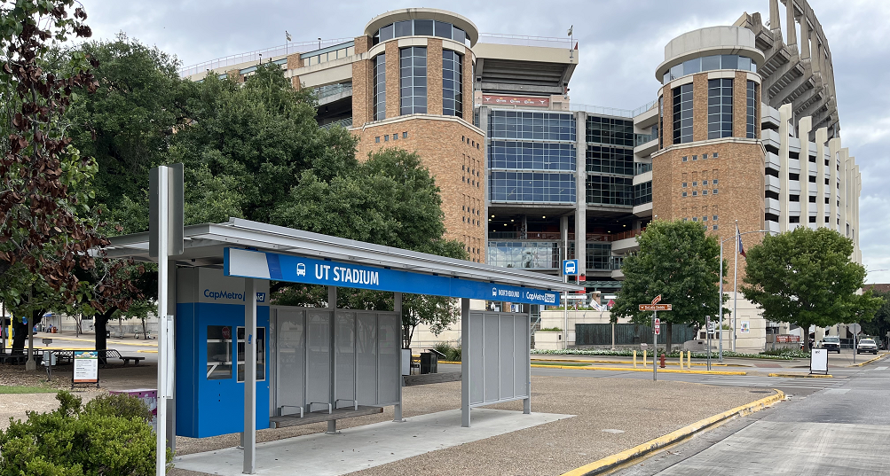
Project Connect Highlights
CapMetro Rapid Lines – vehicles, stations and electric charging
South base demand response operations and maintenance facility
Continued and new Pickup zone operations
Master facility plan expansion
Organizational development and operational readiness
Continued interlocal agreements for capital projects, operations, maintenance and support services

Slide 16
Proposed 5-Year Capital Plan

Slide 17
Next Steps
Review budget proposal with Board advisory committees
Publish draft budget document online
Public outreach across CapMetro’s service area and virtually
Budget updates to Board Committees
Public hearing on the proposed budget
Final Board approval scheduled for September 23
Board update on Long-Range Financial Plan

